Slide 2
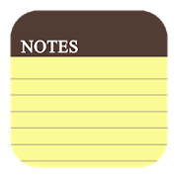
Remember to write Titles, Objectives, dates and underline with a ruler!
This means that you will need to make notes in your exercise book.
This means that this is the section that you will need to make notes on in your exercise book
© Pearson Education Ltd 2020. Copying permitted for purchasing institution only.

Slide 3
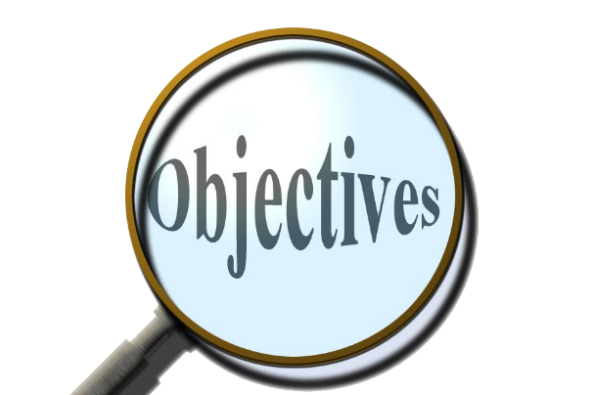
Learning objectives
In this lesson students will learn to:
  Define the term 'procedure'
  Define the term 'parameter'
  Create procedures.
For more information on this topic, and additional student activities, see Topic 1.7 of the student book.
© Pearson Education Ltd 2020. Copying permitted for purchasing institution only.
Notes:
Specification content: 1.1.1 1.1.2 6.1.1 6.6.1 6.6.2

Slide 4
Repeating ourselves
Previously you have learned that you can use loops to repeat blocks of code as many times as you need.
But what happens if you have code you want to re-use multiple times, but not immediately?
What if you want to have the same code work on different input lists, but don’t want to rewrite the code or debug it again?
What if you need to carry out some operation at the start of a program and then again much later? A loop would not be useful to us here.
© Pearson Education Ltd 2020. Copying permitted for purchasing institution only.

Slide 5
Procedures
To solve these problems you can use a programming structure known as a procedure.
Procedures are blocks of code defined separately from the main program. They can be used as many times as you like.
These blocks of code carry out an action of some description. They usually use input parameters.
You’ve already used procedures in your code without knowing it.
© Pearson Education Ltd 2020. Copying permitted for purchasing institution only.

Slide 6
Print
One of the earliest things you learned to do in Python was display values on the screen using print().
print() is an example of a procedure.
The code that makes print work is hidden, but there is code being run by the computer to get the procedure to work.
You give print() some input in the form of parameters. The text and/or variables you type into the brackets are inputs for the print procedure.
© Pearson Education Ltd 2020. Copying permitted for purchasing institution only.

Slide 7
Other examples
You’ve used a few different procedures throughout your programming so far:
  list.append(), list.remove(), del
If you look at help documents online, you will see that these procedures are defined like this:
  <list>.append(<item>)
  <list>.remove(<item>)
  del <list>(<item>)
These definitions tell programmers how to interact with the procedures. The identifiers between the <> are supplied by the programmer.
Procedures carry out an action but do not return any value.
© Pearson Education Ltd 2020. Copying permitted for purchasing institution only.

Slide 8
User-defined procedures
You can also define our own procedures in code.
A key point to remember here is that a procedure definition should occur before the main program.
© Pearson Education Ltd 2020. Copying permitted for purchasing institution only.

Slide 9
Example: creating a procedure
You need to create a procedure that prints out a menu for a larger program.
You should use comments to divide up the sections for maintainability.
def is the keyword to create a procedure.
# ----------------------------------
# Subprograms
# ----------------------------------
def showMenu():
print ("Option 1")
print ("Option 2")
print ("Option 3")
You must have a set of brackets and a colon here.
You should give your procedure a meaningful name.
This procedure does not take input parameters which is why the brackets are empty.
Code inside the procedure is indented. The procedure finishes at the next outdented line.
© Pearson Education Ltd 2020. Copying permitted for purchasing institution only.

Slide 10
Example: creating a procedure with input
You need a procedure that can take any list and output its contents one item at a time.
Again def is used and the procedure given a meaningful name.
The comments have been used to show that this is where the subprograms are defined.
# -----------------------------
# Subprograms
# -----------------------------
def printList(listToPrint):
for item in listToPrint:
print(item)
The value that has been passed into the procedure is being used here.
This time an input parameter has been used.
This means that an item will be passed into the procedure so that something is done with it.
As you'll see on the next slide you can choose the parameter identifier. It does not have to match the name of the value passed into it.
© Pearson Education Ltd 2020. Copying permitted for purchasing institution only.

Slide 11
Example: using your procedure
Using a procedure is known as calling it.
You call your procedures in the main part of your code, after the subprograms have all been defined.
def printList(listToPrint):
for item in ListToPrint:
print(item)
# -----------------------------
# Main program
# -----------------------------
minutes = [15, 23, 12, 7, 18]
printList(minutes)
Comments used to separate subprograms from the main code.
Procedure is defined above.
The values being passed into the procedure are known as an argument.
This creates a list to be used in the procedure.
Calling the procedure by writing the name of it.
The argument does not have the same name as the input parameter, i.e. minutes is different to listToPrint.
© Pearson Education Ltd 2020. Copying permitted for purchasing institution only.
Notes:
Student Activity 1

Slide 12
Arguments? subprograms?
A subprogram is any code block that is defined outside the main program and which can be reused. Procedures are just one kind of subprogram. Functions are another kind of subprogram. You will look at them next lesson.
So far, items in brackets have been labelled as parameters, but:
When you define a subprogram the items in the brackets are known as parameters.
When you call a subprogram the values that are passed into the subprogram using the brackets are known as arguments.
© Pearson Education Ltd 2020. Copying permitted for purchasing institution only.
Notes:
Student Activity 2

Slide 13
IDE tools
It’s important to remember how to use the tools your IDE provides.
They will help you understand what code is doing whilst it’s running.
You should know how to set breakpoints in your code and how to view the contents of variables using the debugging tools.
© Pearson Education Ltd 2020. Copying permitted for purchasing institution only.
Notes:
Demonstration required here using your Integrated Development Environment (IDE)
Student Activity 3

Slide 14
Wrap up: you have learned how to…
Define the term 'procedure’.
  A block of code defined before the main program that can be reused many times.
Procedures carry out an action and do not return a value.
Define the term 'parameter’.
  A value that is passed into a procedure (input).
Create procedures.
  The def keyword is used to create procedures.
© Pearson Education Ltd 2020. Copying permitted for purchasing institution only.

